Slide 1
Electricity and Energy Resources

Slide 2
Producing Electric Current
8.3
From Mechanical to Electrical Energy
Working independently in 1831, Michael Faraday in Britain and Joseph Henry in the United States both found that moving a loop of wire through a magnetic field caused an electric current to flow in the wire.
They also found that moving a magnet through a loop of wire produces a current.

Slide 3
Producing Electric Current
8.3
From Mechanical to Electrical Energy
The magnet and wire loop must be moving relative to each other for an electric current to be produced.
This causes the magnetic field inside the loop to change with time.
The generation of a current by a changing magnetic field is electromagnetic induction.

Slide 4
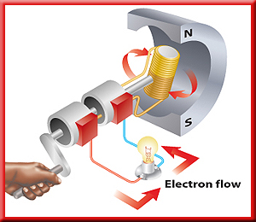
Producing Electric Current
8.3
Generators
A generator uses electromagnetic induction to transform mechanical energy into electrical energy.
An example of a simple generator is shown. In this type of generator, a current is produced in the coil as the coil rotates between the poles of a permanent magnet.

Slide 5
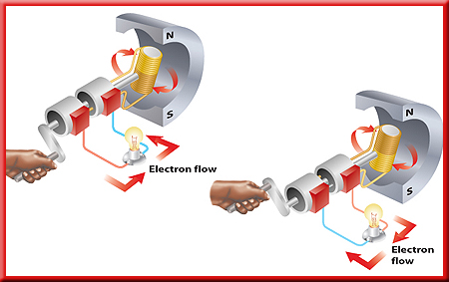
Producing Electric Current
8.3
Switching Direction
In a generator, as the coil keeps rotating, the current that is produced periodically changes direction.
The direction of the current in the coil changes twice with each revolution.

Slide 6
Producing Electric Current
8.3
Switching Direction
The frequency with which the current changes direction can be controlled by regulating the rotation rate of the generator.

Slide 7
Producing Electric Current
8.3
Using Electric Generators
The type of generator shown is used in a car, where it is called an alternator.
The alternator provides electrical energy to operate lights and other accessories.

Slide 8
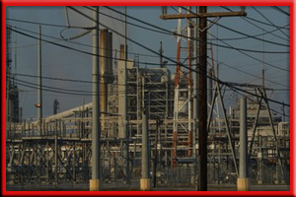
Producing Electric Current
8.3
Generating Electricity for Your Home
Electrical energy comes from a power plant with huge generators.
The coils in these generators have many coils of wire wrapped around huge iron cores.

Slide 9
Producing Electric Current
8.3
Generating Electricity for Your Home
The rotating magnets are connected to a turbine (TUR bine)⎯a large wheel that rotates when pushed by water, wind, or steam.

Slide 10
Producing Electric Current
8.3
Generating Electricity for Your Home
Some power plants first produce thermal energy by burning fossil fuels or using the heat produced by nuclear reactions.
This thermal energy is used to heat water and produce steam.

Slide 11
Producing Electric Current
8.3
Generating Electricity for Your Home
Thermal energy is then converted to mechanical energy as the steam pushes the turbine blades.
The generator then changes the mechanical energy of the rotating turbine into the electrical energy you use.

Slide 12
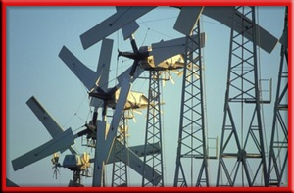
Producing Electric Current
8.3
Generating Electricity for Your Home
In some areas, fields of windmills can be used to capture the mechanical energy in wind to turn generators.
Other power plants use the mechanical energy in falling water to drive the turbine.

Slide 13
Producing Electric Current
8.3
Generating Electricity for Your Home
Both generators and electric motors use magnets to produce energy conversions between electrical and mechanical energy.

Slide 14
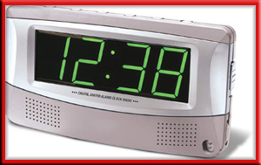
Producing Electric Current
8.3
Direct and Alternating Currents
Because power outages sometimes occur, some electrical devices use batteries as a backup source of electrical energy.
However, the current produced by a battery is different than the current from an electric generator.

Slide 15

Producing Electric Current
8.3
Direct and Alternating Currents
A battery produces a direct current.
Direct current (DC) flows only in one direction through a wire.
When you plug your CD player or any other appliance into a wall outlet, you are using alternating current. Alternating current (AC) reverses the direction of the current in a regular pattern.

Slide 16
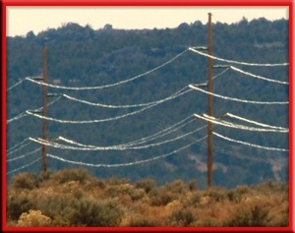
Producing Electric Current
8.3
Transmitting Electrical Energy
When the electric energy is transmitted along power lines, some of the electrical energy is converted into heat due to the electrical resistance of the wires.
The electrical resistance and heat production increases as the wires get longer.

Slide 17
Producing Electric Current
8.3
Transmitting Electrical Energy
One way to reduce the heat produced in a power line is to transmit the electrical energy at high voltages, typically around 150,000 V.
Electrical energy at such high voltage cannot enter your home safely, nor can it be used in home appliances.
A transformer is used to decrease the voltage.

Slide 18
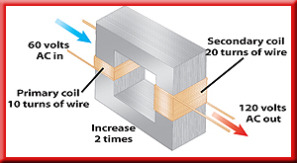
Producing Electric Current
8.3
Transformers
A transformer is a device that increases or decreases the voltage of an alternating current.
A transformer is made of a primary coil and a secondary coil.
These wire coils are wrapped around the same iron core.

Slide 19
Producing Electric Current
8.3
Transformers
As an alternating current passes through the primary coil, the coil’s magnetic field magnetizes the iron core.
The magnetic field in the primary coil changes direction as the current in the primary coil changes direction.

Slide 20
Producing Electric Current
8.3
Transformers
This produces a magnetic field in the iron core that changes direction at the same frequency.
The changing magnetic field in the iron core then induces an alternating current with the same frequency in the secondary coil.

Slide 21
Producing Electric Current
8.3
Transformers
The changing magnetic field in the iron core then induces an alternating current with the same frequency in the secondary coil.

Slide 22
Producing Electric Current
8.3
Transformers
The voltage in the primary coil is the input voltage and the voltage in the secondary coil is the output voltage.
The output voltage divided by the input voltage equals the number of turns in the secondary coil divided by the number of turns in the primary coil.

Slide 23
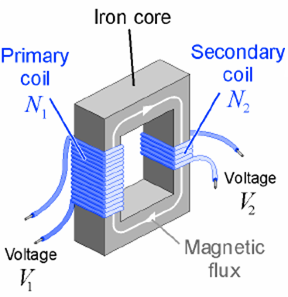
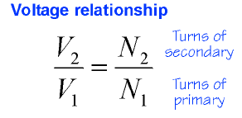
23.3 Transformers
A relationship between voltages and turns for a transformer results because the two coils have a different number of turns.

Slide 24
Producing Electric Current
8.3
Step-Up Transformer
A transformer that increases the voltage so that the output voltage is greater than the input voltage is a step-up transformer.
In a step-up transformer the number of wire turns on the secondary coil is greater than the number of turns on the primary coil.

Slide 25
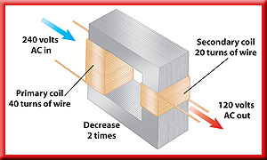
Producing Electric Current
8.3
Step-Down Transformer
A transformer that decreases the voltage so that the output voltage is less than the input voltage is a step-down transformer.
In a step-down transformer the number of wire turns on the secondary coil is less than the number of turns on the primary coil.

Slide 26
Producing Electric Current
8.3
Transmitting Alternating Current
Although step-up transformers and step-down transformers change the voltage at which electrical energy is transmitted, they do not change the amount of electrical energy transmitted.

Slide 27
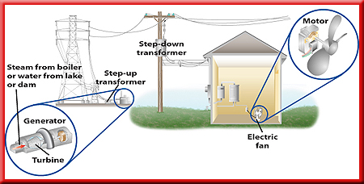
Producing Electric Current
8.3
Transmitting Alternating Current
This figure shows how step-up and step-down transformers are used in transmitting electrical energy from power plants to your home.

Slide 28
Section Check
8.3
Question 1
What is electromagnetic induction?
Answer
Electromagnetic induction is the generation of a current by a changing magnetic field.

Slide 29
Section Check
8.3
Question 2
In a power plant, what is the function of the turbine?

Slide 30
Section Check
8.3
Answer
The turbine is a large wheel that rotates when pushed by water, wind or steam. The plant’s generator changes the mechanical energy of the rotating turbine into electrical energy.

Slide 31
Section Check
8.3
Question 3
Which will increase the voltage of an alternating current?
A. battery
B. generator
C. motor
D. transformer

Slide 32
Section Check
8.3
Answer
The answer is D. Transformers can also decrease voltage, such as in a step-down transformer.

Slide 33
SUMMARY OF E & M
E = Electricity and M = Magnetism are related!!
Both can cause each other
Likes repel
Opposites attract
ELECTRICITY
Can be + or -
Can flow (current)
Can jump (static)
MAGNETISM
Can NOT have only 1 pole
Can be Normal (N) or Reversed (S) pole
Can move through field
Causes sun spots, flares, CME

Slide 34
Reading Assignment
What are sun spots, flares, CME in Magnets?

Slide 35
End of Chapter Summary File

